Slide 1

Welcome to
WOA 70152 Advanced Machine Learning
Saw Shier Nee
sawsn@um.edu.my
Dept. of AI, Fac. of Computer Science and IT, University of Malaya

Slide 2

Innovative Way to Learn Machine Learning
We all learn together - sharing sessions
Students are expected to learn most techniques online by themselves.
What is the use of this course?
This course provides concepts and understandings that cannot be easily self-learned.
This course provides the real life experience for doing deep learning.
This course teaches you how to think in different ways

Slide 3
Four types of people
No skills & cannot explain ideas
Have skills but cannot explain ideas
No skills but can explain ideas
Have skills and can explain ideas
Beggars
Good servants
Bosses
Masters

Slide 4
Who will succeed in the Future?
No skills & cannot explain ideas
Have skills but cannot explain ideas
No skills but can explain ideas
Have skills and can explain ideas
Beggars
Good servants
Bosses
Masters

Slide 5
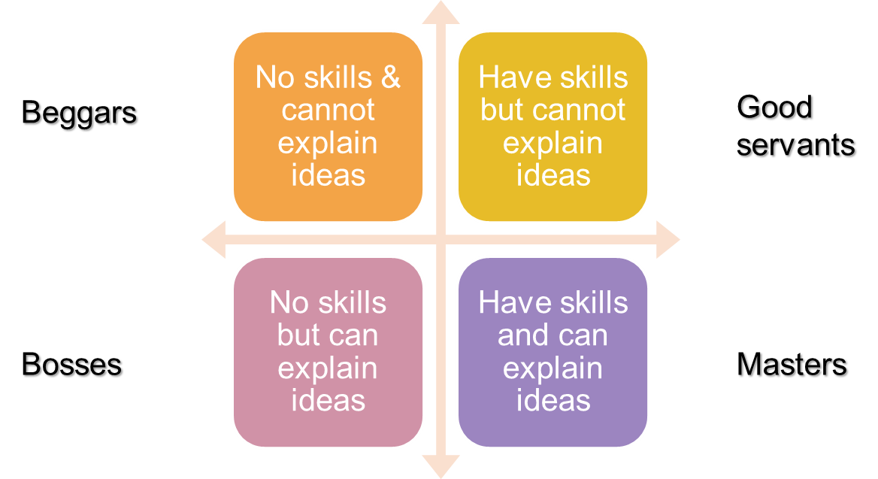
In this course,
We aim to be a master

Slide 6
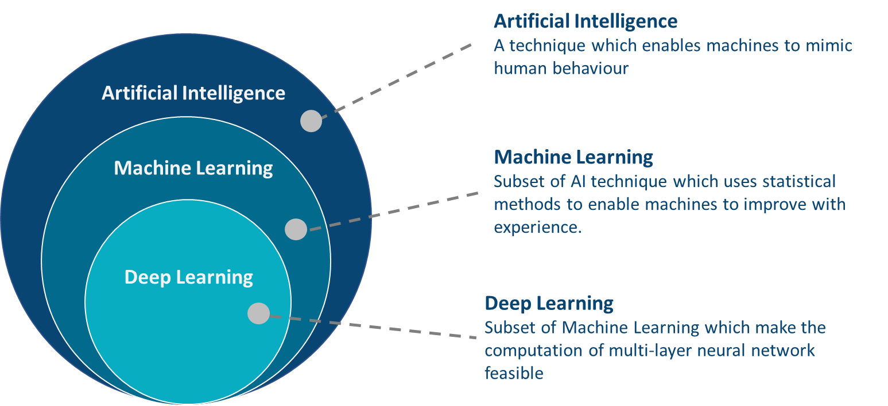
What is AI? ML? DL?

Slide 7
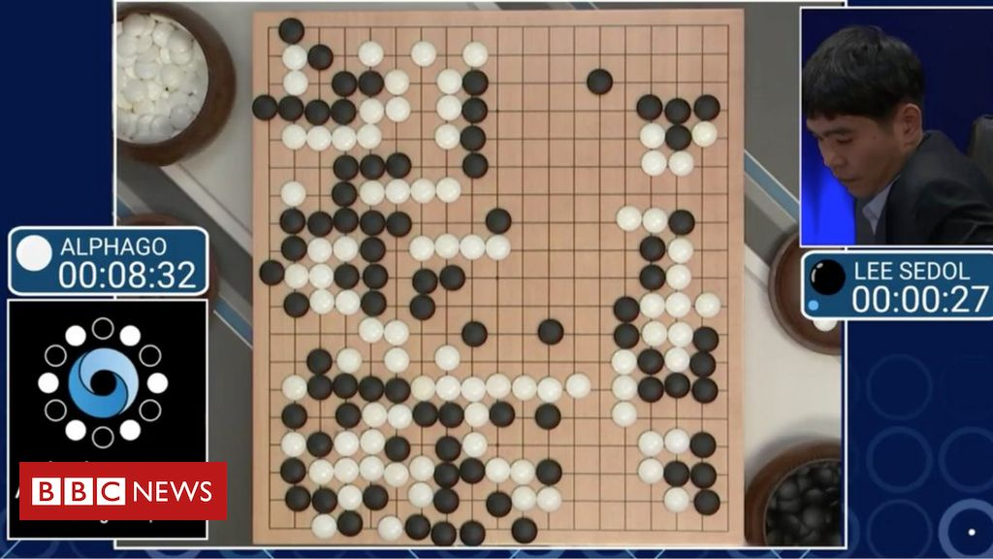
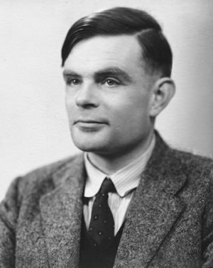
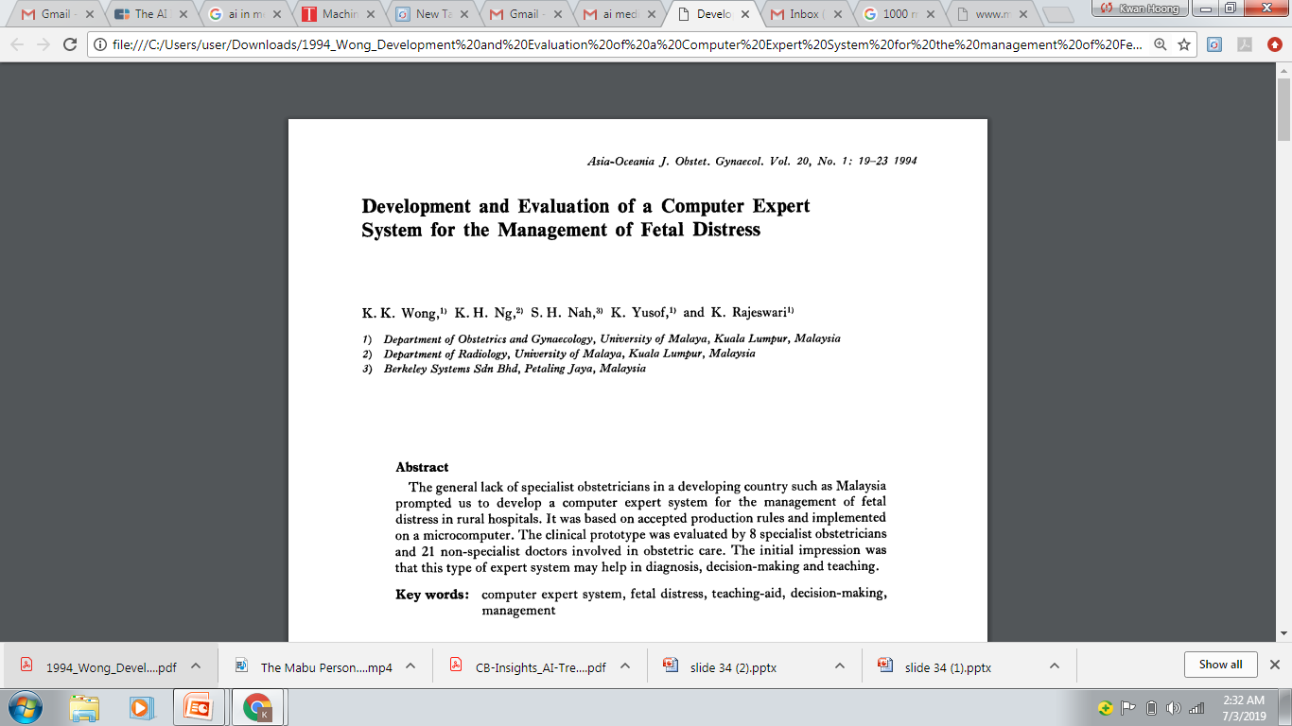
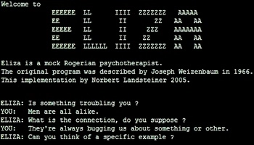
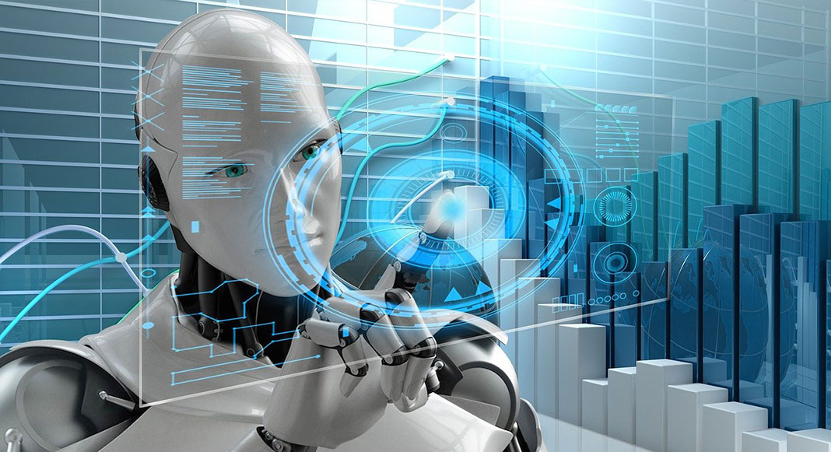
History of AI
“Can machines think?”
Alan Turing introduce a method for machine intelligence
First AI Winter
Second AI Winter
https://www.bbc.com/news/technology-35785875
Alpha Go defeated Lee Sedol, world champion of Go
https://editions.covecollective.org/chronologies/alan-turing-%E2%80%9Ccomputing-machinery-and-intelligence%E2%80%9D-1950
1950
1966
1975
1980
1987
2016
Now
First Chatbot: ELIZA
Expert System
AI in everywhere
https://www.computerhope.com/jargon/e/eliza.htm
Notes:
The history of AI starts very early. In 1950s, at the dawn of computing, Alan Turing asked the question: "Can machines think?“ and he then introduced a method to test machine intelligence. This was at a time when the first general purpose computers had only just been built. In 1966, the first chatbox – ELIZA was built. Unfortunately, AI entered the first winter in 1975 where not much people were interested in such topics and no fundings were available to support this research. In 1980, it started to gain attraction again where expert system were built. In fact, UM also involved in this where they had developed a computer expert system to manage fetal distress. In 1987, AI entered the second winter again because the system was too difficult to maintain, to update and was unable to learn. Until 2016, Alpha GO was announced to defeat Lee Sedol, the world champion of GO. This shows the world how powerful a computer can be. And then, now AI in everywhere, be it in automotive, manufacturing or healthcare.

Slide 8
Impact of AI
AI
Manufacturing
Healthcare
Agriculture
Education
Media
Retail
Transportation
Notes:
Transportation - Autonomous Car
Manufacturing - AI powered robots performing assembly and stacking task.
Healthcare - Drug discovery speeds up; More accurate disease diagnosis ; Big data helps in personalized patient experience
Education - AI to gauge student emotions to help determining who’s struggling / bored; Tailor experience to individual needs.
Media - Bloomberg uses AI to analyse financial reports; Associated Press uses NLP to automate production of earning reports
Customer Service - Google is developing AI assistant to understand human-like call for appointments.
Agriculture - Precision farming technique to increase yield.

Slide 9
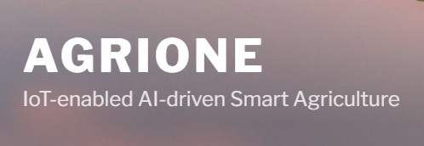

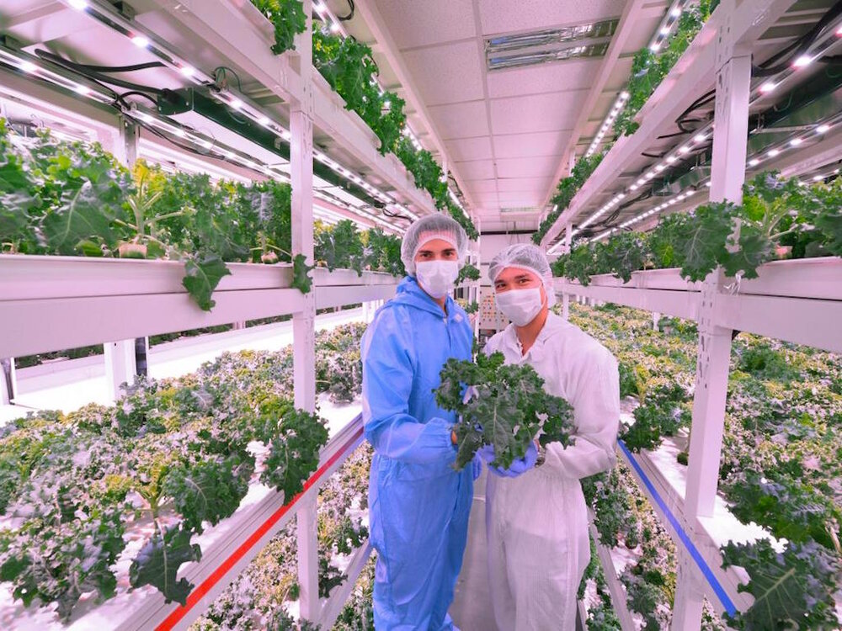
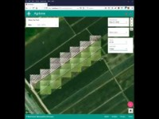
Agriculture

Slide 10
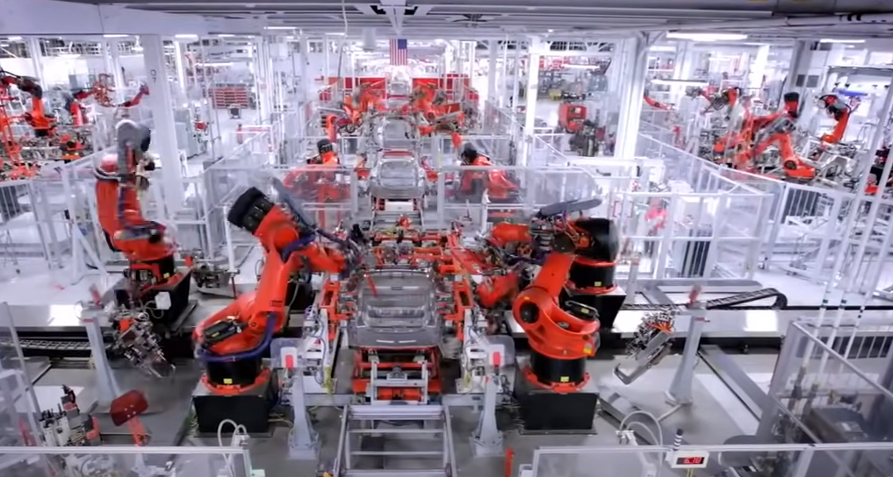
Manufacturing
Inside Tesla's Crazy AI Manufacturing Revolution
https://www.youtube.com/watch?v=uobJbNyGVjo&ab_channel=CasgainsCapital

Slide 11
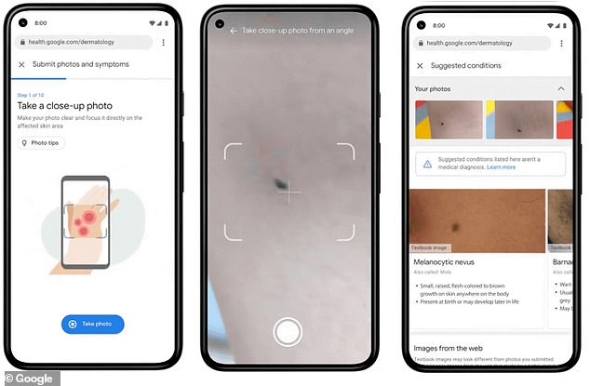
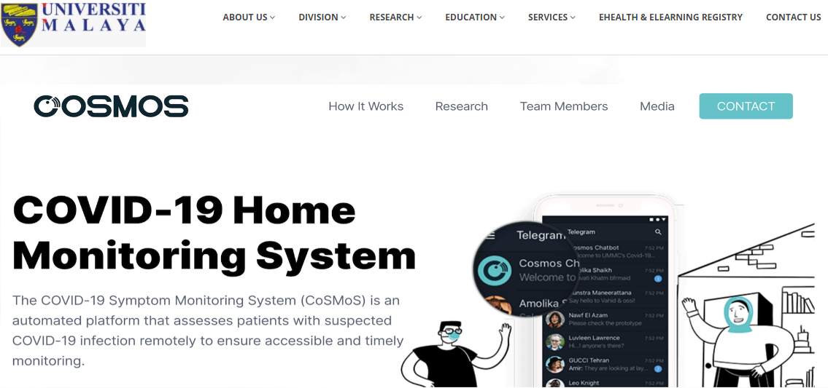
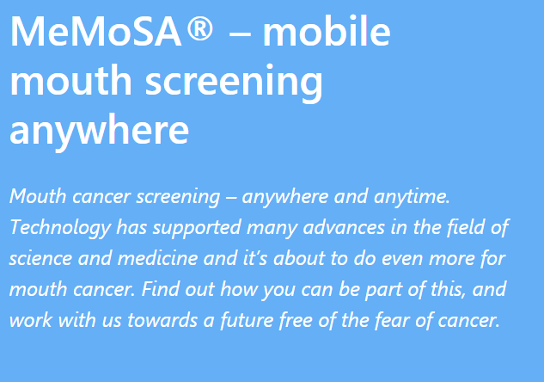

Healthcare
Google Skin Condition Prediction
https://australiannewsreview.com/google-unveils-ai-tool-that-can-identify-288-skin-conditions/

Slide 12
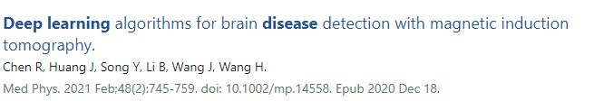
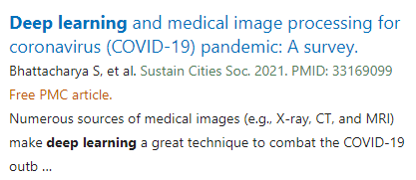
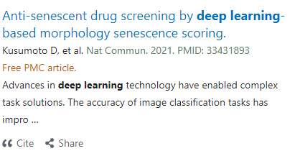
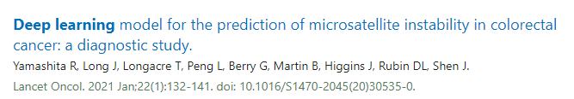
Healthcare – 2021’s papers

Slide 13
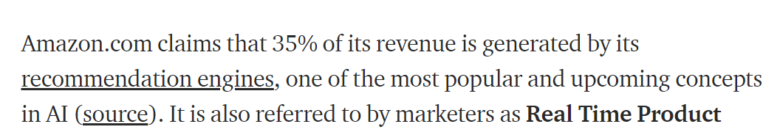
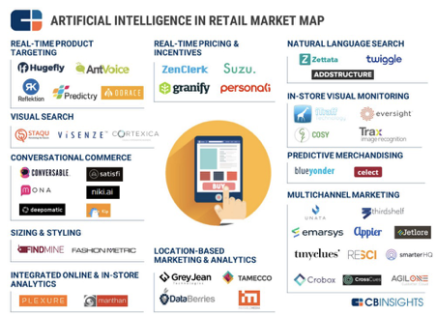
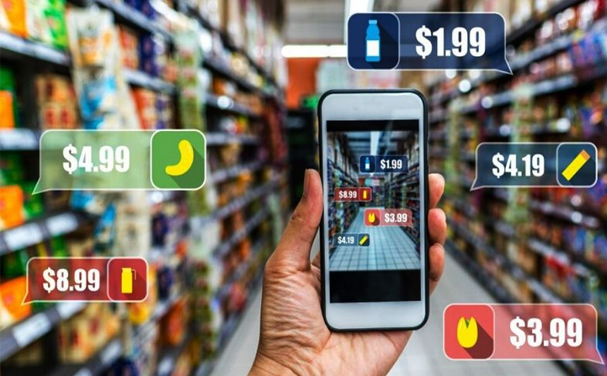
Retails
u
https://usmsystems.com/top-use-cases-of-artificial-intelligence-in-retail-industry/
https://medium.com/@humansforai/retail-d4ca38b4de3f
Notes:
Product recommendations to customers according to their search history
Demand Prediction & Management
Pricing Strategy
Personalization

Slide 14

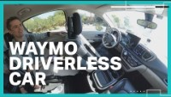
Transportation
Tokyo – Autonomous Taxi
Waymo company - self-driving minivans and trucks
https://asia.nikkei.com/
Notes:
In Tokyo, autonomous taxis have already begun operating but the driver sits in the car for safety reasons to be able to take control of the taxi in case of emergency situations
Waymo company has introduced self-driving minivans and trucks within a certain number of states for testing on public roads.

Slide 15
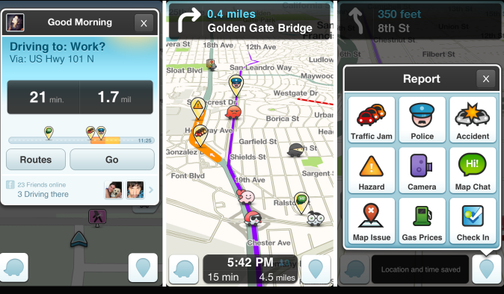
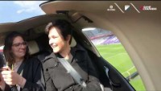
Transportation - Traffic
Drone Taxi

Slide 16
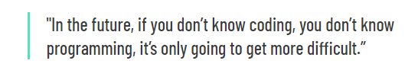
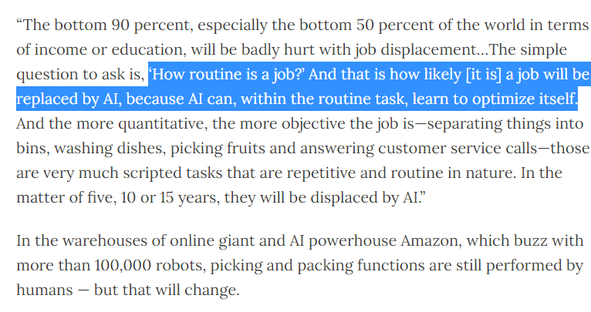
How AI affect employment?

Slide 17
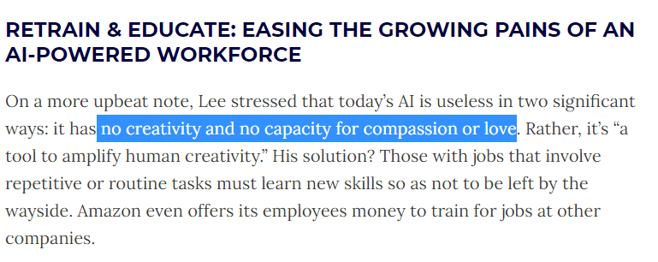
Current AI limitation

Slide 18

AI Robot - Sophia

Slide 19
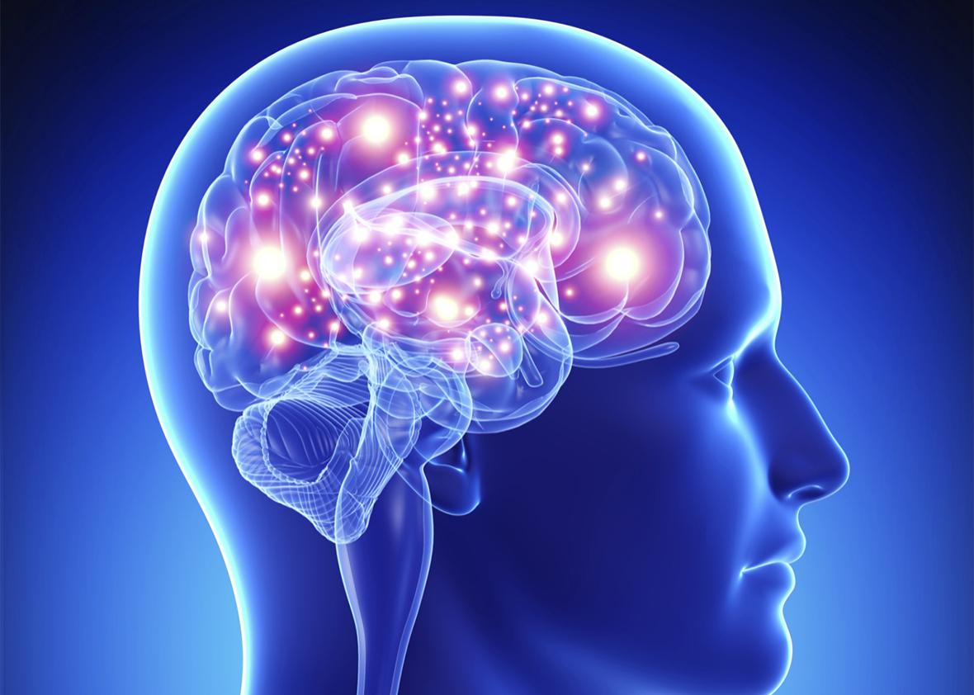

How human brain works?
86 billions of neurons
https://www.livescience.com/29365-human-brain.html
Notes:
Human brain is roughly 1.4kg, made up of 2% of our body weight. It actually made up of 60% fat. Human brain contains about 86 billion neurons..

Slide 20
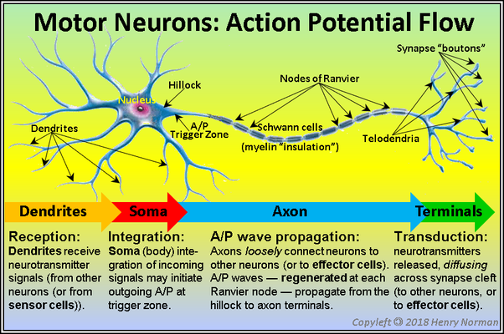
How information is transmitted via neurons?
Notes:
Information are passes

Slide 21
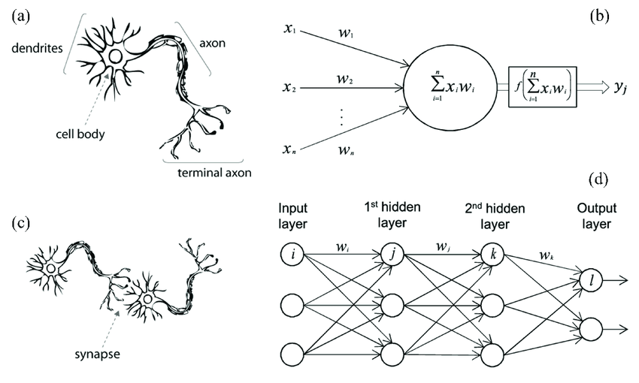
Deep learning Intuition
https://www.researchgate.net/publication/339446790_Using_a_Data_Driven_Approach_to_Predict_Waves_Generated_by_Gravity_Driven_Mass_Flows
Notes:
Information are passes

Slide 22
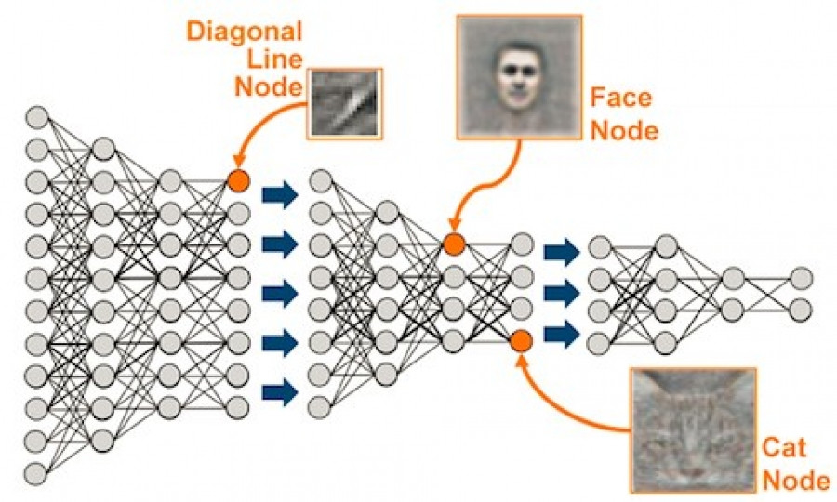
Deep learning
Notes:
Information are passes

Slide 23
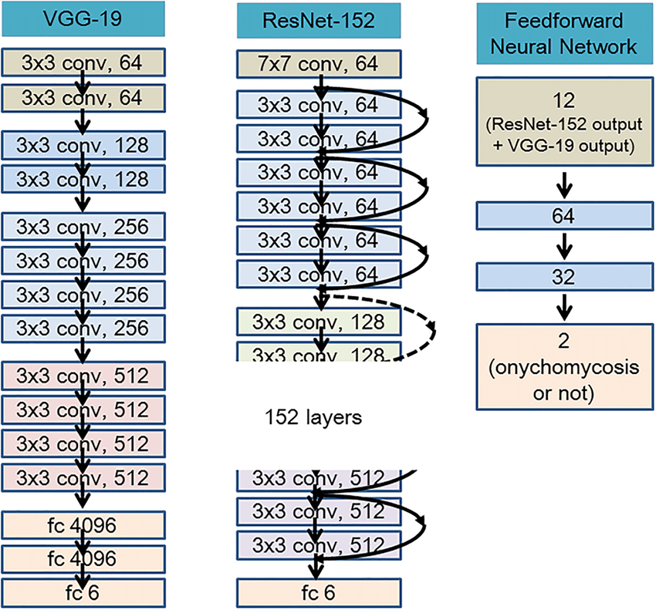
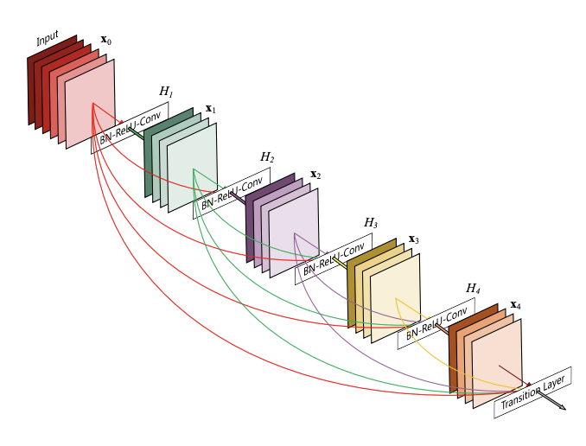
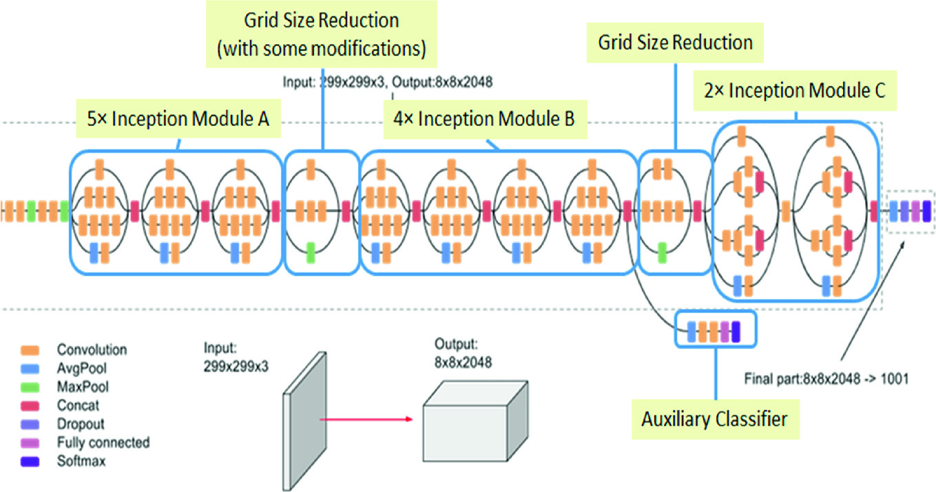
Deep learning
DenseNet
InceptionNet
Notes:
Information are passes

Slide 24
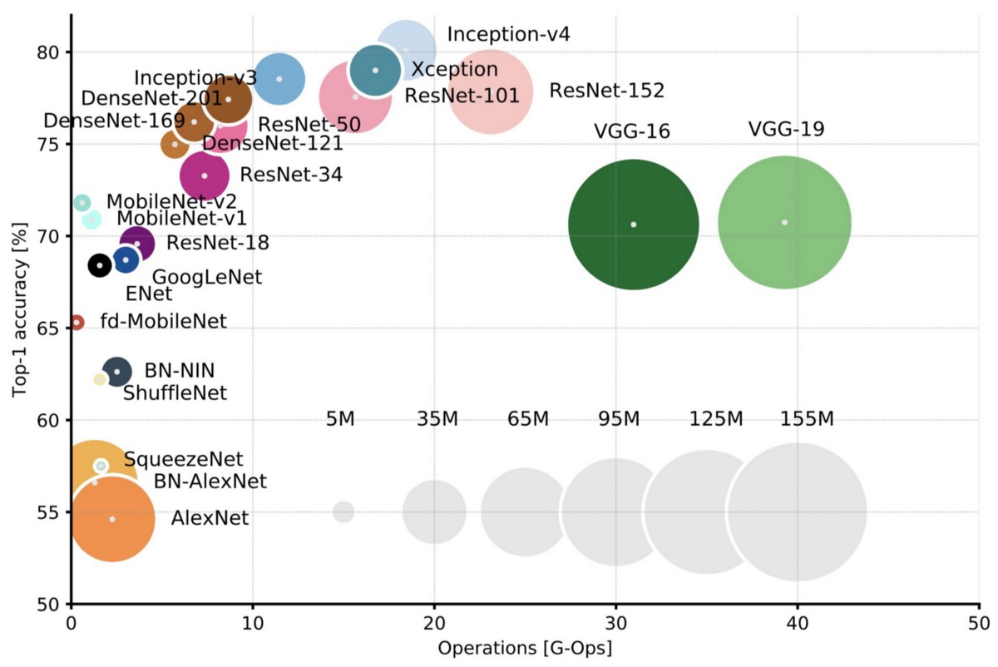

Deep learning - Accuracy vs Operation
Model complexity
Computing Resources
https://towardsdatascience.com/neural-network-architectures-156e5bad51ba
Notes:
Top-1 one-crop accuracy versus amount of operations required for a single forward pass.

Slide 25

How we learn?
Input
Output
Unclear input
Unclear output
Precise Input
Precise output

Slide 26

How we teach machine to learn?
Input
Output
Unclear input
Unclear output
Precise Input
Precise output

Slide 27
Different levels
Can get results but cannot judge if the output is reasonable
Can understand what they doing and can explain
Can combine methods to create new things in Deep Learning
Can fundamentally change deep learning in research

Slide 28
Design AI is not difficult
Prerequisite: Coding

Slide 29
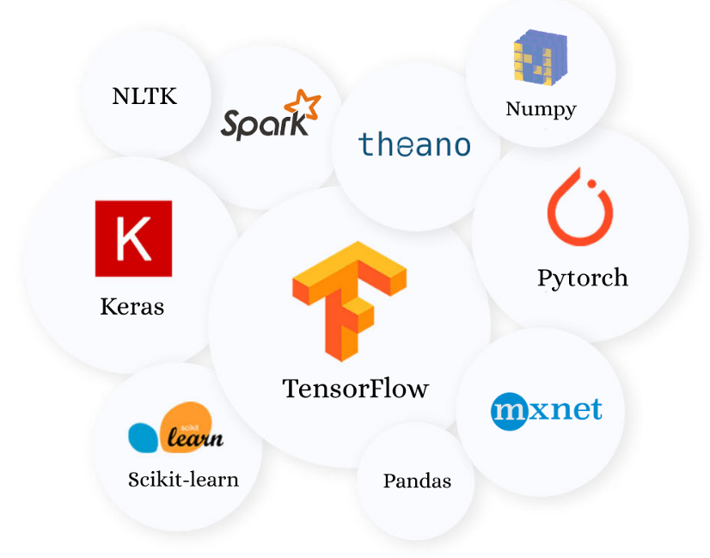
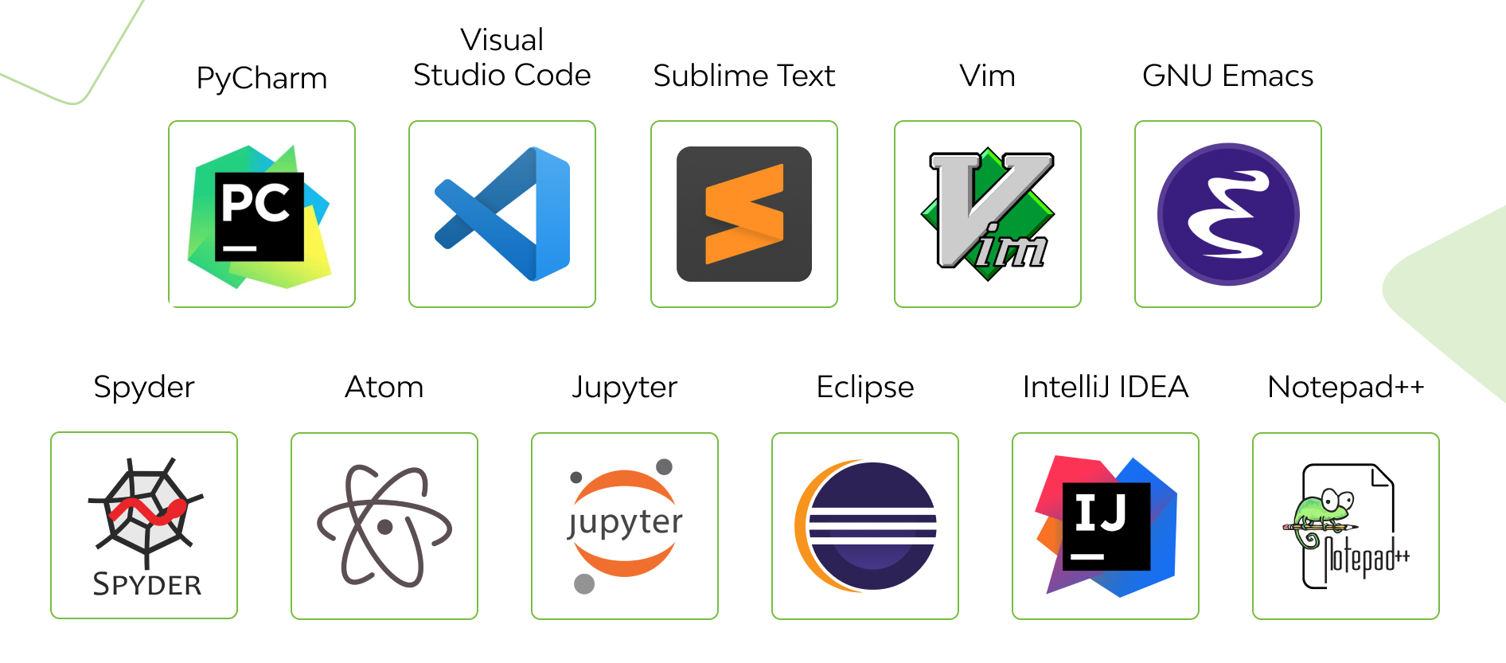

Design AI is not difficult
Libraries
Integrated Development Environment (IDE)

Slide 30

What is your coding level? Write your real name.
ⓘ Start presenting to display the poll results on this slide.

Slide 31

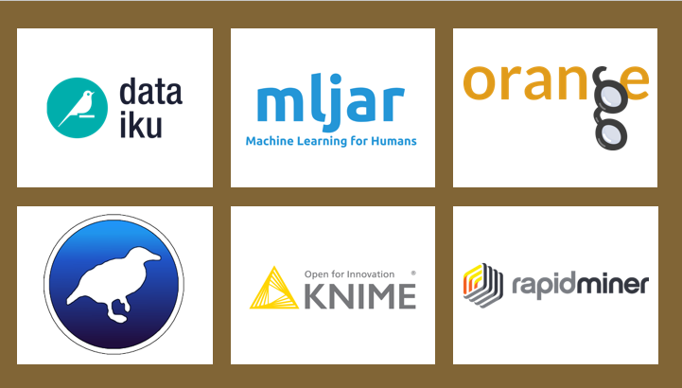


Code-less Platform – Drag and Drop

Slide 32
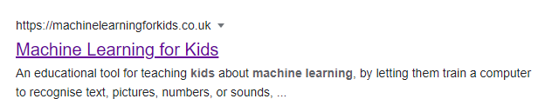
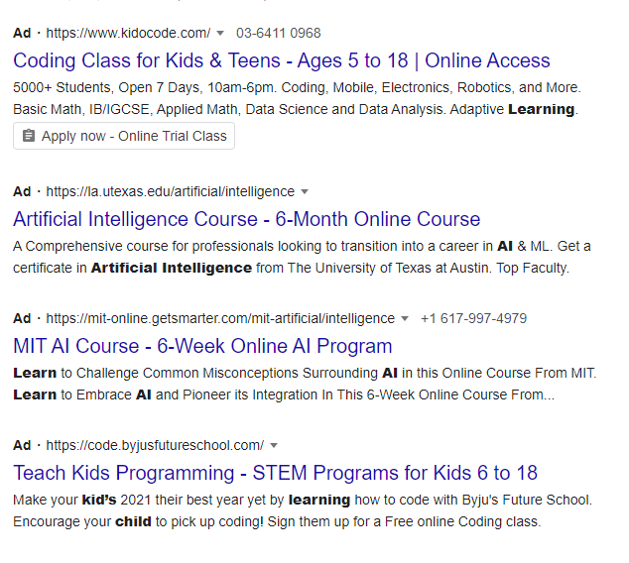
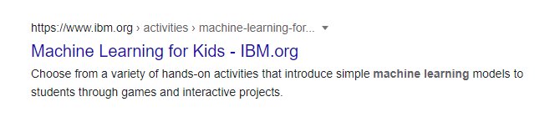
Everyone is learning AI

Slide 33
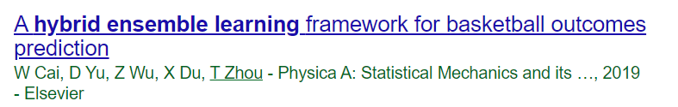
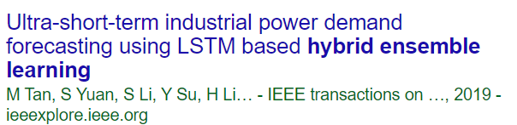
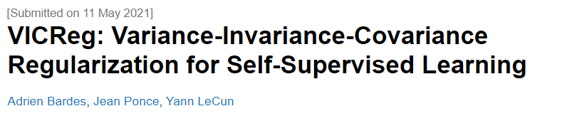
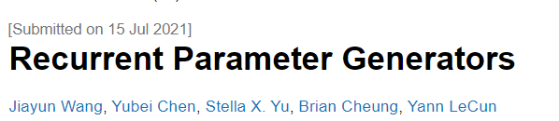
What set us apart?
Can get results but cannot judge if the output is reasonable
Can understand what they doing and can explain
Can combine methods to create new things in Deep Learning
Can fundamentally change deep learning in research

Slide 34
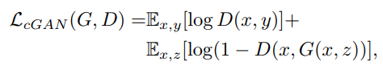
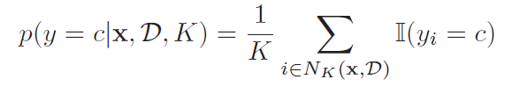
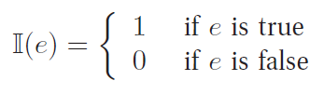
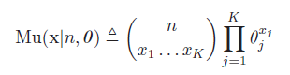
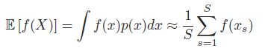
Go into the maths
Can get results but cannot judge if the output is reasonable
Can understand what they doing and can explain
Can combine methods to create new things in Deep Learning
Can fundamentally change deep learning in research

Slide 35
Let’s play a game. Refresh your maths

Slide 36

Can you guess the simplicatioin of this equation?
Material from C.S.Chan

Slide 37

Material from C.S.Chan

Slide 38
What to expect?
Basic fundamental of probability
Using probability theory to develop machines that can learn from data.
Maths involved.

Slide 39
Assessment
Assignment – 50% (week 4 – 8 – Spectrum )
Group Projects – 50%
Pre-submission report – 10%, (week 13 - Spectrum)
Presentation – 20%, (week 14)
Final Report Submission – 20%, (week 15 - Spectrum)

Slide 40
Group Project – 50%
Group Project Report (70% converted to 30%)
At least 2000 words (reference, figures, tables and appendix are excluded). Not longer than 6000 words.
Group’s Rubric (55%)
Problem definition + Objective – 5%
Proposed Machine Learning method – 30%
Experimental study results + Insight – 15%
Codes used – 5%
Individual’s Rubrics (15%)
What have you learnt? – 10% (any infographic / mindmap)
Reflect yourself on your strength (2.5%) and weakness (2.5%).
Presentation (20% converted to 20%)
Presentation Flow – 15%
QnA - 5%

